Slide 1
Creating a RESTful Web Service
I'm Randal Kamradt – Building REST services for 10 years.
All code for this presentation, including these slides is on GitHub at https://github.com/rkamradt/my-first-rest
On twitter at @rkamradt
Blogging about programming at https://rlkamradt.wordpress.com/

Slide 2
Creating a RESTful Web Service
Prerequisites:
Git command line
Node.js
Software for compiling native Node modules
MongoDB
Grunt command line
A GitHub account
Access to the command line
A Text editor or IDE

Slide 3
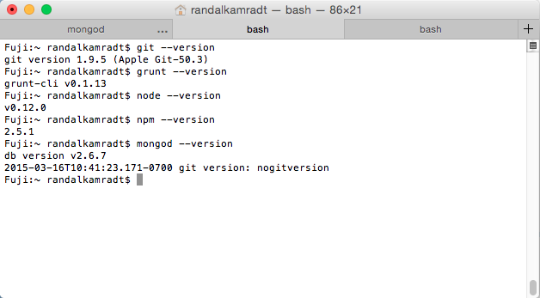
Check all prerequisites

Slide 4


What is RESTful
Representational State Transfer.
Uses HTTP verbs GET, PUT, POST, DELETE.
Uses common HTTP status codes.
Very simple to implement with an HTTP server.
Very simple to access via the Internet.
Not a standard. Consensus among implementers.
Many common front-end frameworks expect it.
For more information go to : http://en.wikipedia.org/wiki/Representational_state_transfer

Slide 5
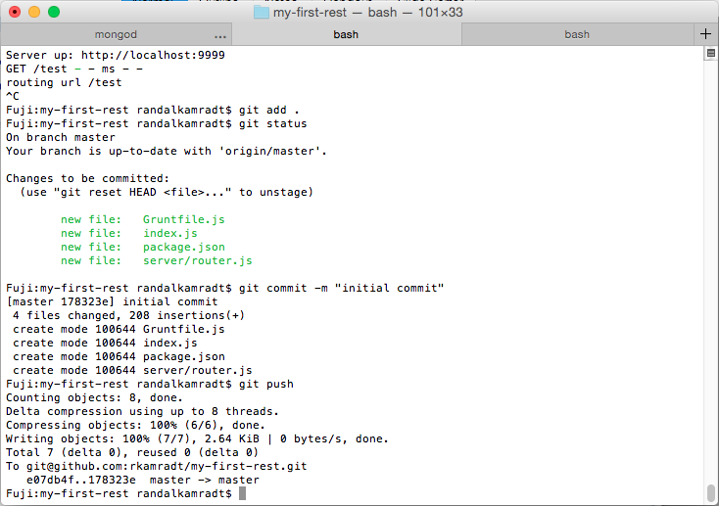
Kill server (ctrl-c) and save project

Slide 6
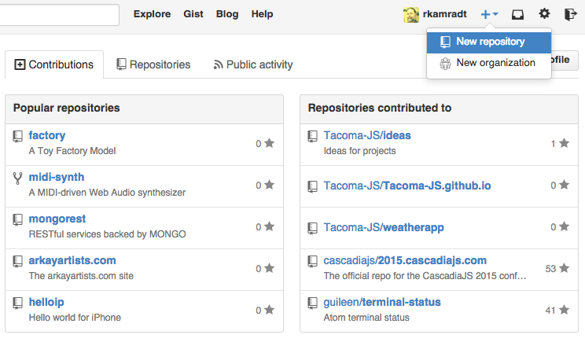
Create A GitHub Repo

Slide 7
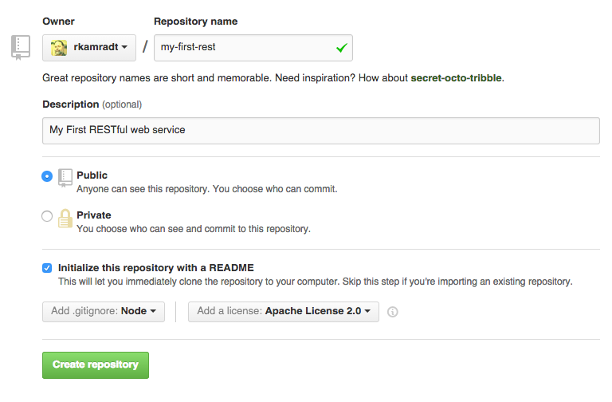
Fill in basic details

Slide 8
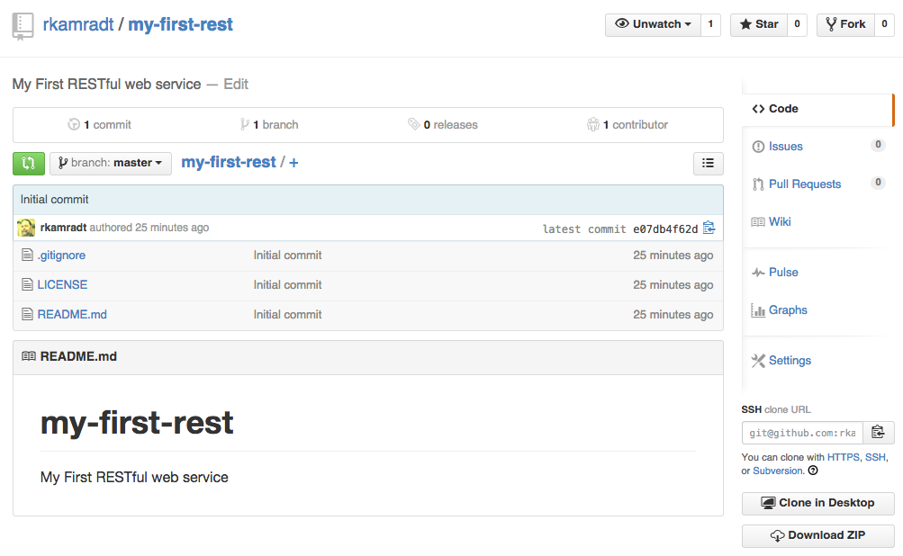
Copy URL to clipboard

Slide 9
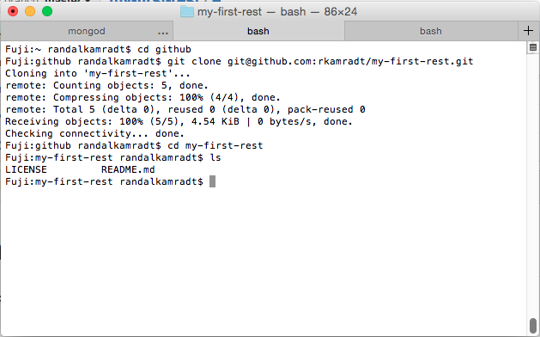
Clone repo to local drive

Slide 10
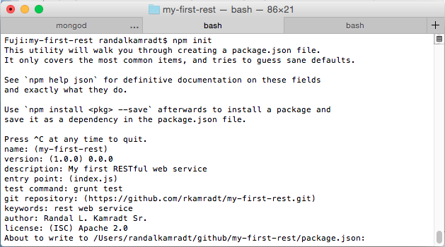
Create NPM Project

Slide 11
Install Dependencies
Runtime dependencies:
npm install –save
express
body-parser
method-override
mongodb
morgan

Slide 12
Install Dependencies
Development dependencies:
npm install –save-dev
grunt
grunt-contrib-clean
grunt-contrib-copy
grunt-contrib-jshint
grunt-contrib-watch
grunt-express-server
grunt-simple-mocha
jshint
load-grunt-tasks
mocha
should

Slide 13
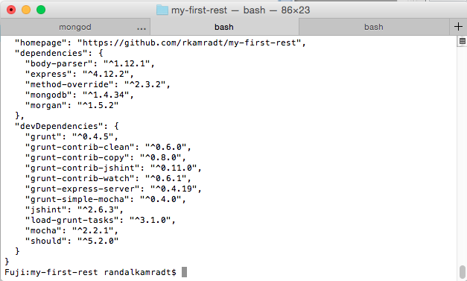
Check package.json

Slide 14
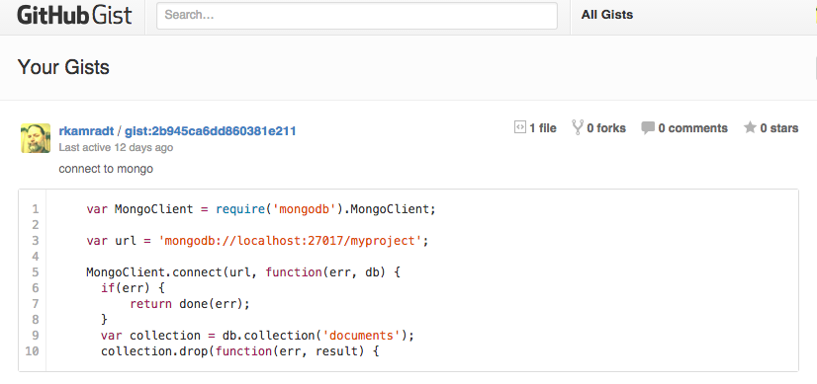
Browse to my Gists https://gist.github.com/rkamradt

Slide 15
Using a text editor or IDE copy the gists into your project
Gruntfile.js: basic express grunt file
index.js: server.js
server/router.js: Skeleton Express Route

Slide 16
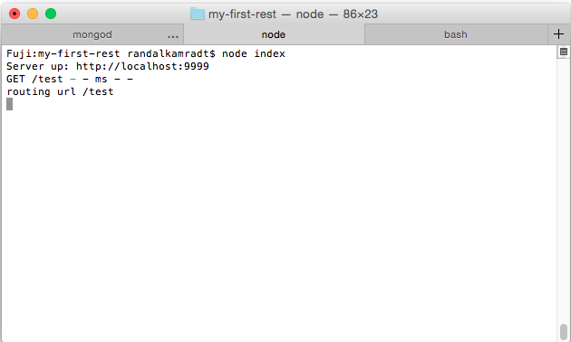
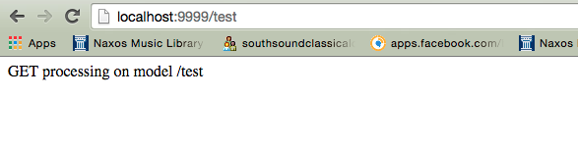
Run server and browse to it

Slide 17
Kill server (ctrl-c) and save project

Slide 18
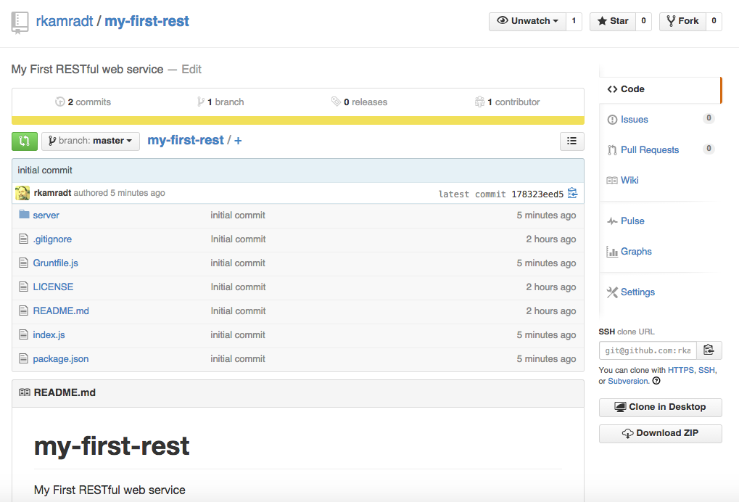
Go back and check GitHub

Slide 19
Create a dataloader for Mongo
Copy the mongoload.js gist into server/mongoload.js
Create a directory called test and a file in it called test-data.js

Slide 20
Fill in test-data.js with an array of strings
{ "data":
[
{ "name": "mercury" },
{ "name": "venus" },
{ "name": "earth" },
{ "name": "mercury" },
{ "name": "mars" },
{ "name": "jupiter" },
{ "name": "saturn" },
{ "name": "neptune" },
{ "name": "uranus" }
]
}

Slide 21
Add mongoloader to server.js:
var mongoload = require('./server/mongoload');
mongoload.load(function(err) {
if(err) {
console.log('error loading data into mongo');
return;
}
http.createServer(app).listen(9999, function() {
console.log('Server up: http://localhost:' + 9999);
});
});

Slide 22
Add Mongo get to router.js
var mongoload = require('./monogload');
...
if(req.method === 'GET') {
mongoload.getAll(function(err, result) {
if(err) {
res.status(500).send(err.message).end();
} else {
res.status(200).send(JSON.stringify(result)).end();
}
});
return; // dont end until after callback
} else...

Slide 23
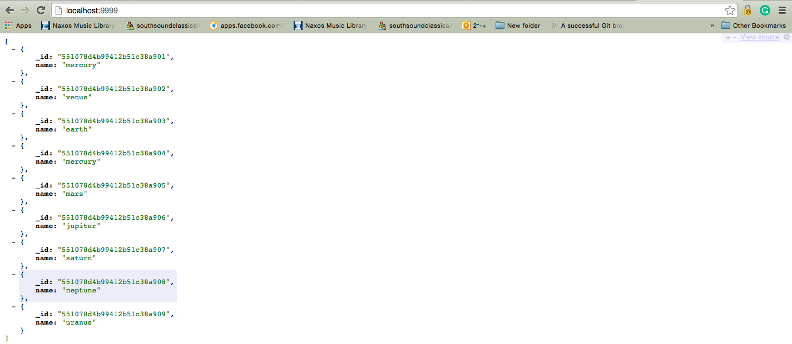
Run server again and browse to it

Slide 24
Making a RESTful Web Sevice
(the easy way)
Change directory to backout of your project (cd ..)
Make a new directory and change to it
Run sudo npm install -g yo
Run sudo npm install -g generator-meanjs
Run yo meanjs
Run grunt
Open browser to http://localhost:3000

Slide 25
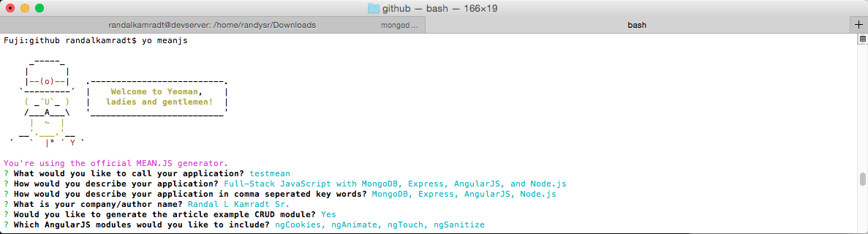
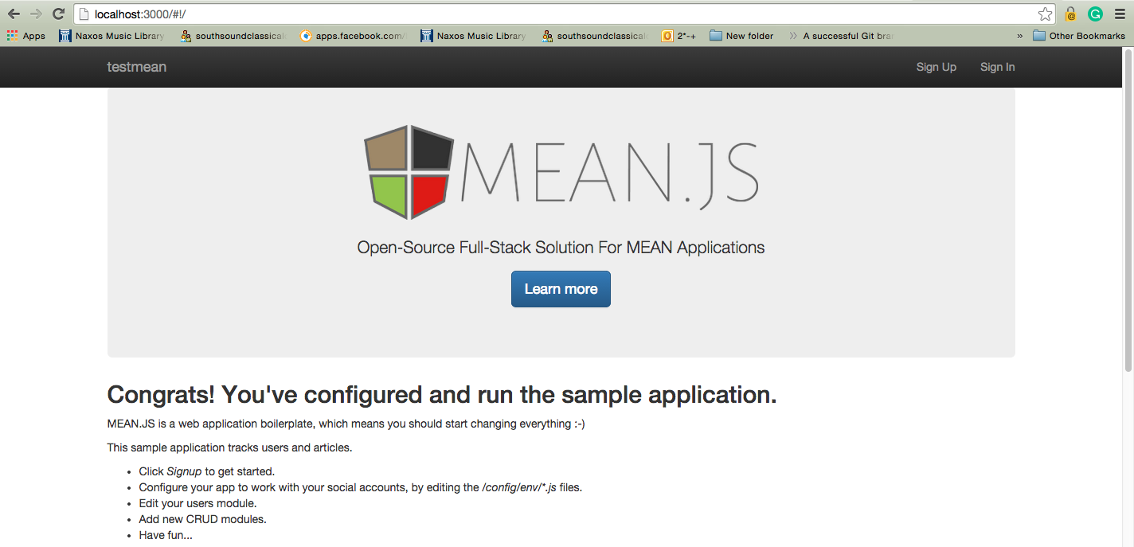
Yoeman Boilerplate

